Slide 1
Sector-oriented pr demonstrator
Intel Labs

Slide 2
Legal Disclaimers
Intel provides these materials as-is, with no express or implied warranties.
All products, dates, and figures specified are preliminary, based on current expectations, and are subject to change without notice.
Intel processors, chipsets, and desktop boards may contain design defects or errors known as errata, which may cause the product to deviate from published specifications. Current characterized errata are available on request.
Intel technologies' features and benefits depend on system configuration and may require enabled hardware, software or service activation. Performance varies depending on system configuration. No product or component can be absolutely secure. Check with your system manufacturer or retailer or learn more at http://intel.com.
Some results have been estimated or simulated using internal Intel analysis or architecture simulation or modeling, and provided to you for informational purposes. Any differences in your system hardware, software or configuration may affect your actual performance.
Intel, Quartus, Stratix, the Intel logo and the Stratix logo are trademarks of Intel Corporation in the United States and other countries. Other names and brands may be claimed as the property of others. *Other names and brands may be claimed as the property of others.
© Intel Corporation 2020

Slide 3
Sector NoC Infrastructure
North, East, South, West In/Out ports for data transfer (AVMM)
Data packet will be stored in FIFO of destination sector
Security filter can be enabled/disabled during runtime to block/unblock data transfer to any sector
PR region controllers for each NESW Ports and controlled via out-of-bound signals (conduit) from the Master

Slide 4
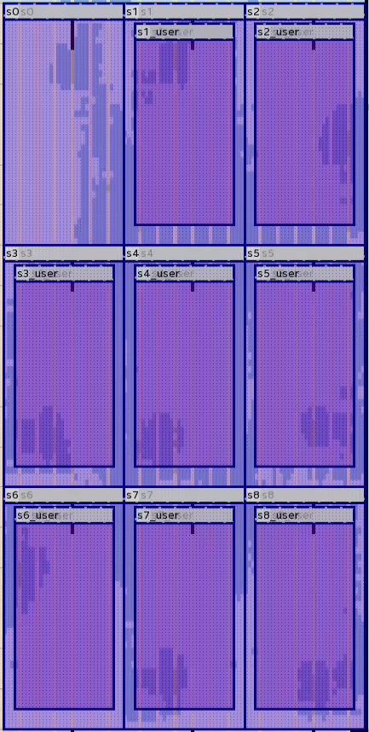
3x3 NoC
Sector 0-8
Sector 0 as the Master with debug interface
Logic-lock placement
Parent partition is sector-aligned
Entire sector (NoC + user logic)
Child partition at the centre of a sector
User logic only
Performance
Frequency 100MHz; Fmax 133MHz
Sector-sector bandwidth 133MHz / 12 cycles latency * 4 bytes/transfer = 44MB/s (non-burst)
Resource Utilization
NoC infrastructure resource varies from sector to sector
Ranges from 1000 - 2000 ALMs per sector

Slide 5
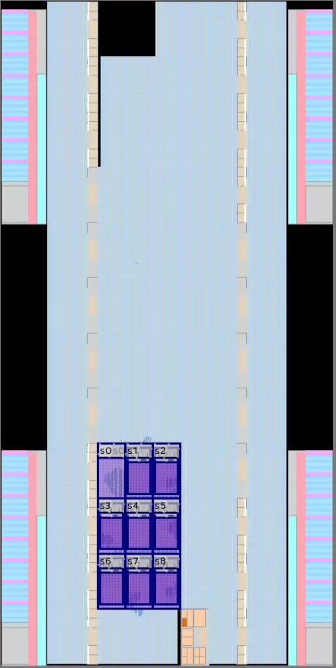
Partial Reconfiguration 101
Ability to reconfigure part of the design (PR region); while the rest of the design is running (static region)
Default .sof will configure the entire chip, both static and PR regions (orange boxes)
Child partition can be recompiled with different user logic persona while NoC infrastructure in parent partition for each sector remains the same
Parent.rbf (sector-aligned) will be configured to achieve sector PR
Adjacent interfaces of PR region must be frozen prior to PR to avoid unknown data/command being asserted
Static Region
C
B
A
PR regions

Slide 6
PR Mechanism
Example: Sector 4 Reconfiguration
Master asserts freeze requests to PR region controllers of neighbouring ports (in red)
Master asserts reset to sector 4
Program sector 4 parent_partition.rbf
Master asserts unfreeze requests to PR region controllers
Master de-asserts reset

Slide 7
Demo
Each user logic consists of Nios II Processor, memory, unique system ID
The processor will poll the status of local FIFO periodically and upon detecting data it will return the data + ID to master (sector 0)
All commands will be sent from the master via System Console
Dev kit: Stratix 10 GX FPGA Development Kit H-tile (ES)
Images are compiled using Quartus v18.0
ID
Data

Slide 8
Board bring-up
Program test_noc.sof using Programmer
In System Console, source demo script
System reset via jtag_debug_reset_system
open_service master for sector0 master

Slide 9
Command list
sXwr <data>
Sector0 master writes <data> to sector
E.g. s1wr 0x1111
sXfreeze
Sector0 master freezes sectorX PR region controllers and reset sectorX
E.g. s1freeze
sXunfreeze
Sector0 master unfreezes sectorX PR region controllers and de-asserts reset to sector
E.g. s1unfreeze
sXfilter <data>
Enable security filter of sector
E.g. s1filter 0x1
regwr <addr> <data>
Sector0 master writes <data> to <addr>
E.g. regwr 0x100 0x5678
regrd <addr>
Sector0 master reads from <addr>
E.g. regrd 0x40000
sector_write <data>
Sector0 master writes <data> to all 8 sectors
E.g. sector_write 0x5376
fiford <num>
Sector0 master reads from local FIFO for <num(decimal)> of times
E.g. fiford 8

Slide 10
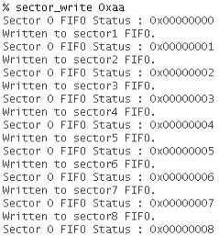
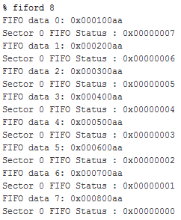
Sanity Check
Master writes to 8 sectors
Each sector should return the data + ID to master
FIFO Count increases with each write
Read 8 Master’s FIFO data
<- From sector1
<- From sector2
<- From sector3
<- From sector4
<- From sector5
<- From sector6
<- From sector7
<- From sector8

Slide 11


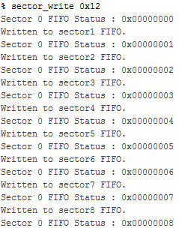
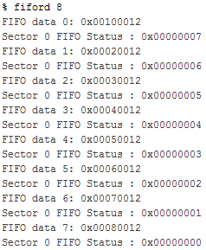
Sector Partial Reconfiguration
Master asserts freeze requests to PR region controllers and reset to PR sector
Close master service in System Console and program test_noc_v2.s1_parent_partition.rbf in Programmer
Reopen master service and send unfreeze request
Repeat sanity check
ID changed from 1 to 10

Slide 12

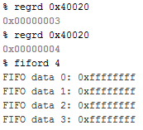
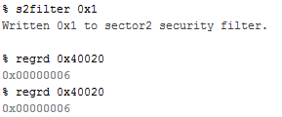
Security Filter
PR a sector with ‘bad’ rbf which repetitively writes 0xFFFFFFFF to sector 0 every few seconds
Enable security filter of data from that sector to sector0
Sector 0 will no longer receive data from that sector
Read sector0 FIFO count
Bit | Field | Default value | Descriptions
0 | Sector 0 access | 0 | Write 1 to this bit to block access to sector0. Write 0 to this bit to allow access to sector0.
1 | Sector 1 access | 0 | Write 1 to this bit to block access to sector1. Write 0 to this bit to allow access to sector1.
2 | Sector 2 access | 0 | Write 1 to this bit to block access to sector2. Write 0 to this bit to allow access to sector2.
3 | Sector 3 access | 0 | Write 1 to this bit to block access to sector3. Write 0 to this bit to allow access to sector3.
4 | Sector 4 access | 0 | Write 1 to this bit to block access to sector4. Write 0 to this bit to allow access to sector4.
5 | Sector 5 access | 0 | Write 1 to this bit to block access to sector5. Write 0 to this bit to allow access to sector5.
6 | Sector 6 access | 0 | Write 1 to this bit to block access to sector6. Write 0 to this bit to allow access to sector6.
7 | Sector 7 access | 0 | Write 1 to this bit to block access to sector7. Write 0 to this bit to allow access to sector7.
8 | Sector 8 access | 0 | Write 1 to this bit to block access to sector8. Write 0 to this bit to allow access to sector8.
FIFO count increasing without any write
Enable filter to block data transfer from sector2 to sector0
FIFO count no longer increasing
Security Filter Control Register

Slide 13
NoC Limitations
NoC infrastructure of each sector is static as the sector AVMM addresses are hard-coded
Current design doesn’t support burst data transfer
Sectors are not able to trace the origin of incoming data
Frozen state during PR will impact data transfer of other sector

